Slide 1

Sweet!

Slide 2
“Academic excellence CAN coexist with delight.”
-Finland, the WORLD leader in Education

Slide 3

We’ve come to believe…
“Academic excellence should coexist with delight.”

Slide 4
Aligning Standards to Activities
Now, this is the key to everything we try to do. Doing fun activities is one thing, but if you don’t align it to what kids need in their grade level and all of the grade levels you’re working with, you aren’t doing them any favors.
They will not pick up what they need from just doing a fun activity with you, the activity must have a purpose and a focus.

Slide 5

How do we know what kids really need to know?
How do we know specifically what kids need in each grade level?
What real modifications can we make in our instruction to make sure we are not just teaching to the middle and hoping everyone gets something out of it?

Slide 6
A tool we use: Common Core & TN Standards
(our spreadsheet)

Slide 8

A cross-curricular approach
We work to integrate standards based subject matter and skills from multiple content areas into one cohesive learning experience.
We also believe that our instruction needs to be to what students need to get from the lesson.
This includes not only Science, Technology, Engineering, and Math, as well as Social Studies, Geography, Reading, Writing, History, Art, Media, Current Events, Cultural Awareness, Career Awareness, and more.

Slide 9

Making real-world connections
It is a way to help learners recognize natural connections between separate subjects. No more, “When am I ever going to use/need this?”

Slide 10

Keeping it all in mind
We’re going to do a quick run-through of the activities in the Sweet! lesson and we’d like you to try and think of what skills and standards you might be able to teach through each of the following activities.

Slide 11
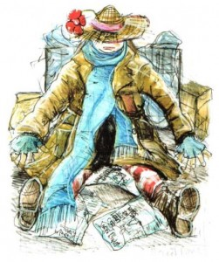
Teller of Tales!
Invite your students to step into a magical world where houses can be eaten and all is not quite what it seems…

Slide 12
http://theplayhouse.org.uk/hanselandgretel/files/2010/10/Invite.pdf

Slide 13
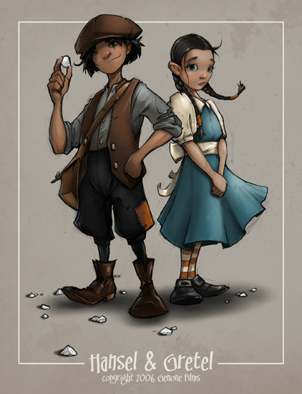
Hansel & Gretel: A Sweet & Sour Story!
If you end up lost in the woods...you may just find yourself.
The story of Hansel and Gretel is a well-known fairy tale. What’s interesting is that there are similar versions of this story all over the world, and they developed independently of each other. Students compare and contrast versions from around the world of this classic tale of family, famine, infanticide, abandonment, starvation, cannibalism, and of course, candy!
Image credit: http://creaturebox.com/artwork/hansel-and-gretel/ Copyright 2006. All Rights Reserved.

Slide 14
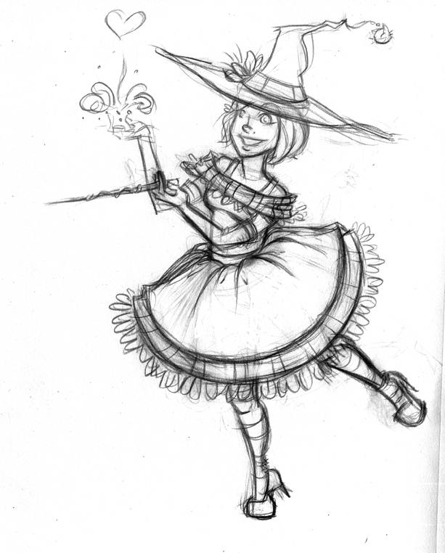
Things Aren’t Always as They Seem
But what if what’s well known isn’t what’s right? What if things are not always as they seem? What if we rethink the traditional construction of the witch as an evil character?
In this activity we discuss and help students distinguish between fact/opinion and cause/effect before writing an Upside Down Story, turning all the events in the real story into the witch's (or another character’s) perspective, and giving her version of events using some sweet treats in place of nouns, adjectives, and verbs.
Image Credit: Cat Ferris, Artist for Hire. Copyright 2012. All Rights Reserved. Go to her blog for more amazing art at http://www.cattifer.com/blogalog/ . She is available for commissions, comics work, illustrations, and storyboards. Contact her @: cattifer(at)gmail(dot)com.

Slide 15
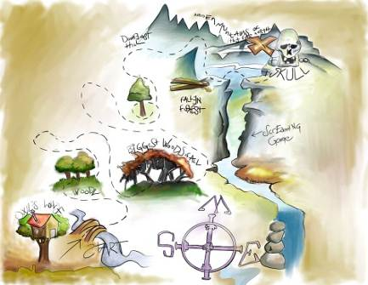
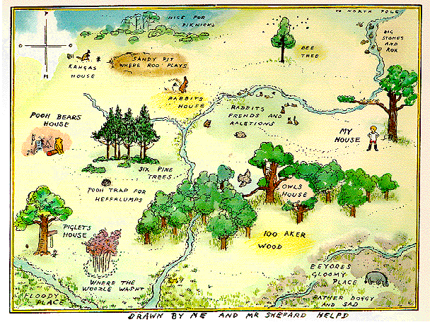
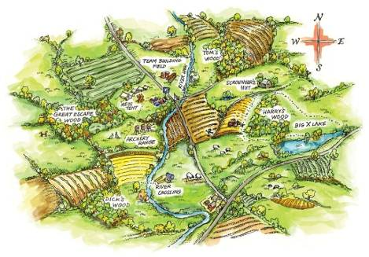
Are we there yet?
Draw a Hansel & Gretel story map as a response to literature.
Add cartography details such as waterways, roads, mountains and water inlets.
Study the use of cartography to enhance works of fiction

Slide 16

The Price is Right!
FOR SALE! Sweet, Rustic, Serene, & Scrumptious Cottage! Located next to a charming brook with scenic views and in a very exclusive neighborhood. One bedroom, one bath, with loft. New working oven and pet cages included!

Slide 17
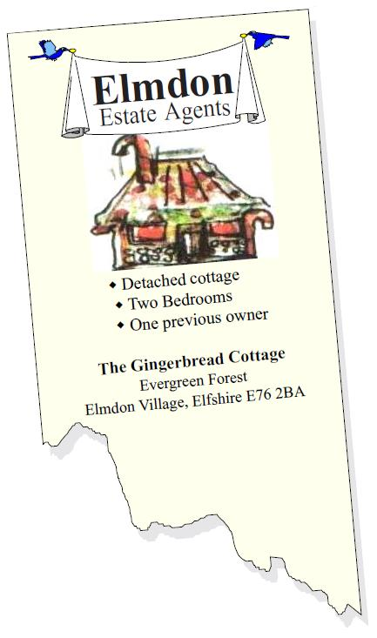
The Price is Right!
Students bid on classified ads (noting their favorite descriptions) with a budget they decide on to get an idea of what homes are really going for.
Then they create their own classified ad for the witch’s cottage (incorporating words and phrases they liked from real ads) and hold a class auction.
The team that “ties up” the most real estate by bidding correctly and staying within their budget wins!

Slide 18
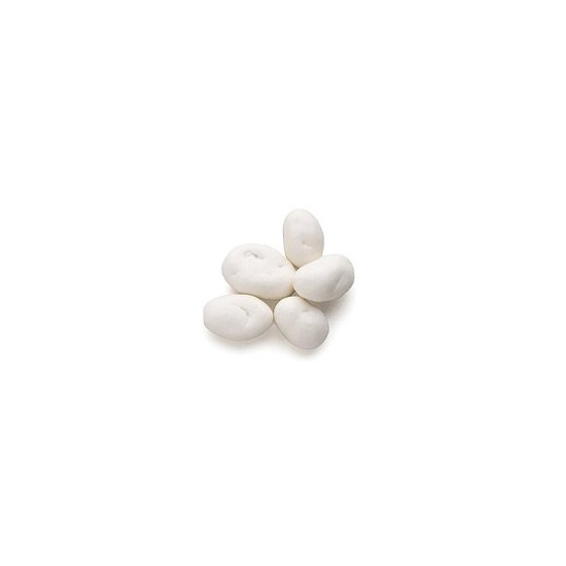
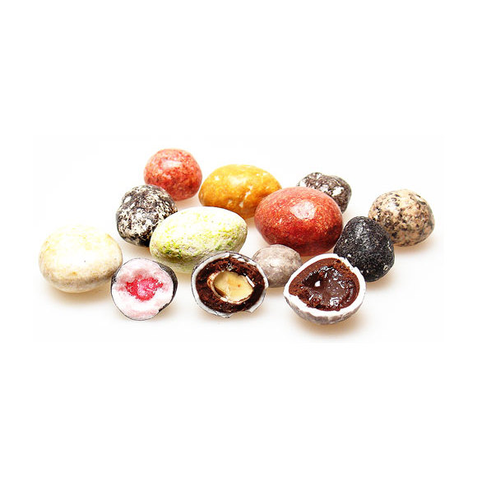
Crumbs
We are about to embark on a journey to escape the woods. Much like the ill-fated siblings, students must follow a trail of crumbs (in the form of written clues) to progress through the forest. Some clues may be tricky ones left by the witch and some may be helpful crumbs of knowledge left by the birds.
Variations: Have students write grammatically correct clues for the other team to follow. Students enjoy watching the other team try and follow their clues. Just caution them to keep quiet and not give the location away!
Have a Hansel & Gretel “Find Your Way Home” Trail Mix at the end for students that they measure and mix themselves.

Slide 19

Scrumdidlyuptious!
Read fun kids books about candy, ex. Little Pea to access prior knowledge
After reading, ask students to share their own experiences, favorites, and ideas about candy & the story answering the five W + H questions (i.e., Who, What, When, Where, How, Why) to demonstrate understanding of key details in a text.
Discuss history of candy
Character Design & Image Credit: Dacosta! @Chocolate Soop® Copyright 2012. All Rights Reserved! http://vector.tutsplus.com/articles/case-study/the-making-of-a-chocolate-bar-character//

Slide 20
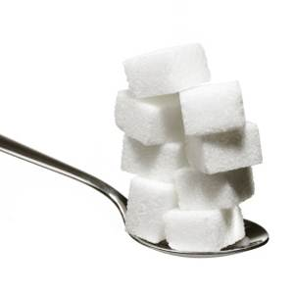
A Spoonful of Sugar Helps the…
Explore the medicinal history of candy

Slide 21
Chocomania Begins!
Chocolate. There are few foods that people feel as passionate about -- a passion that goes beyond a love for the "sweetness" of most candies or desserts: after all, few people crave caramel, whipped cream, or bubble gum. Chocolate is, well, different. For the true chocoholic, just thinking about chocolate can evoke a pleasurable response.
We explore the history of this beautiful bean!

Slide 22

Sweet Math O’Mine
Students must navigate through an enchanted forest filled with dangerous villains and perplexing basic math problems. Okay, not really, but there will be a few perplexing math problems and a lot of fun to make your heart skip a beat!

Slide 23

Speed ‘em UP! Ship ‘em OUT!
For a fun introduction to this section students watch the classic I Love Lucy Chocolate Factory Clip: https://www.youtube.com/watch?v=D6LUg-siJVs or at http://www.tv.com/shows/i-love-lucy/job-switching-15119 [has commercials, full episode, start after 12:58 or later]

Slide 24
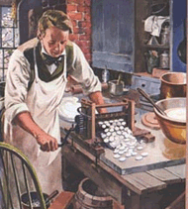
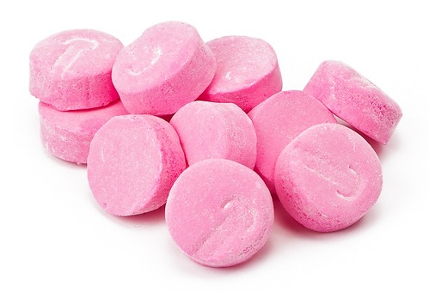
Speed ‘em UP! Ship ‘em OUT!
Discuss the first industrially produced candies, NECCO wafers, invented by a pharmacist!
As the first machine-cut sweets emerged from the press, the modern world of candy was born, and the beginning of the American candy industry.

Slide 25
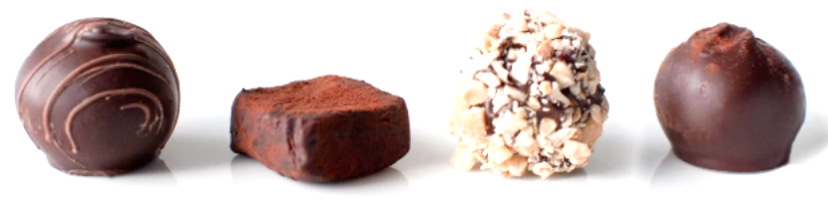
Dipped, Dusted, & Rolled…
Crafting Handmade Chocolates
Students learn how to make homemade truffles and the science behind that crispy crunch!
We introduce it by having students watch the beginning of the classic I Love Lucy Chocolate Factory episode at http://www.tv.com/shows/i-love-lucy/job-switching-15119

Slide 26

From Bean to Bar
Students Go on a video tour of a chocolate factory and learn the chocolate-making process.

Slide 27
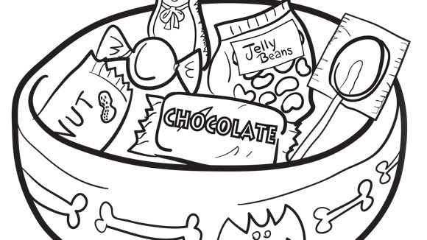
Wrap it Up! I’ll take it!
Students learn the complex history of confectionary packaging and discover the impact of a great wrap

Slide 28
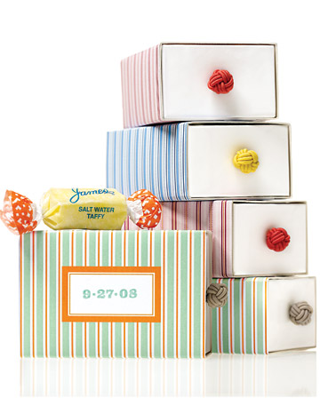
Make Your Own Candy Boxes!
Students use origami and paper weaving to construct their own pretty packaging
and make tiny tags!

Slide 29
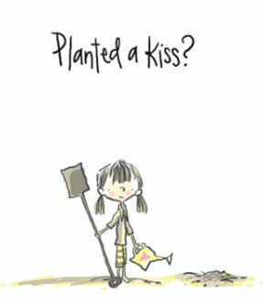
Plant a Kiss & Watch it Grow!
Unexpected gifts have a magic all their own, For even the simplest acts of kindness and magic can change the world.
Your student’s mission is to go out in the world and spread a little color, connection, caring, art and magic by “planting kisses” in their own creative ways. One of the ways we’re going to do is with a pen, paper, & paint, and a bit of chocolate.

Slide 30

Plant One, On Me!
Students package up a “kiss” (ex. 2 individually wrapped truffles, box(es), tag, & art) and pick a person to plant it on. Include a note on the little tag attached instruct the recipient to keep a kiss for themselves and share the other with someone else, ex. “One for you, and one to share!”, or “Keep one kiss and pass one along. Let's spread the Kindness in honor of Plant a Kiss Day!” For even the tiniest (and tastiest) acts of kindness can change the world. Plant a seed…and let it grow!

Slide 31
What Standards and Skills Came to Mind?

Slide 32

A Very Sad Question
“This is nice and all, but can stuff like this really affect test scores?”
  What do you think is the answer to raising test scores?
  Is there only one answer?

Slide 33
This is nice and all, but can stuff like this really affect test scores?
Let’s see!
Working together in your group talk about what we’ve done today, modify your instruction for your group’s assigned grade-span to two or three specific standards.
Then we’ll have everyone report.

Slide 34
There’s a few we’ve thought of…and more that could go.
What did you find?

